Slide 1


Hanna Farsin
24-06-2025

Slide 2

Outline
Executive Summary
Introduction
Methodology
Results
Conclusion
Appendix

Slide 3
Executive Summary
Summary of methodologies
Data Collection through API
Data Collection With Web Scraping
Data Wrangling
Exploratory Data Analysis With SQL
Exploratory Data Analysis With Data Visualization
Interactive Visual Analytics With Folium
Machine Learning Prediction
Summary of all results
Exploratory Data Analysis Result
Interactive Analytics in Screenshots
Predictive Analytics Result

Slide 4
Introduction
Project background and context
Space X advertises Falcon 9 rocket launches on its website with a cost of 62 million dollars; other providers cost upward of 165 million dollars each, much of the savings is because Space X can reuse the first stage. Therefore if we can determine if the first stage will land, we can determine the cost of a launch. This information can be used if an alternate company wants to bid against space X for a rocket launch.
The goal of the project is to create a machine learning pipeline to predict if the first stage will land or not.

Slide 5

Section 1

Slide 6
Methodology
Executive Summary
Data collection methodology:
Data was collected through SpaceX API and web scraping from wikipedia
Perform data wrangling
Data is processed by removing missing values,filtering launch outcomes,cleaning landing outcomes mainly one hot encoding.
Perform exploratory data analysis (EDA) using visualization and SQL
Perform interactive visual analytics using Folium and Plotly Dash
Perform predictive analysis using classification models
How to build, tune, evaluate classification models

Slide 7
Data Collection
The data is collected using 2 methods :Request to SpaceX API and through Web scraping:
Request to SpaceX API :
We have to make a get request to the SpaceX API.
Request the rocket launch data from SpaceX API in json format
Now we decode the response content as a Json using .json and turn it into a Pandas dataframe using .json_normalize()
also did some basic data wrangling and formatting.
Web Scraping:
performed web scraping to collect Falcon 9 historical launch records from a Wikipedia page titled `List of Falcon 9 and Falcon Heavy launches`.
Web scrap Falcon 9 launch records with `BeautifulSoup`:
Extract a Falcon 9 launch records HTML table from Wikipedia
Parse the table and convert it into a Pandas data frame

Slide 8
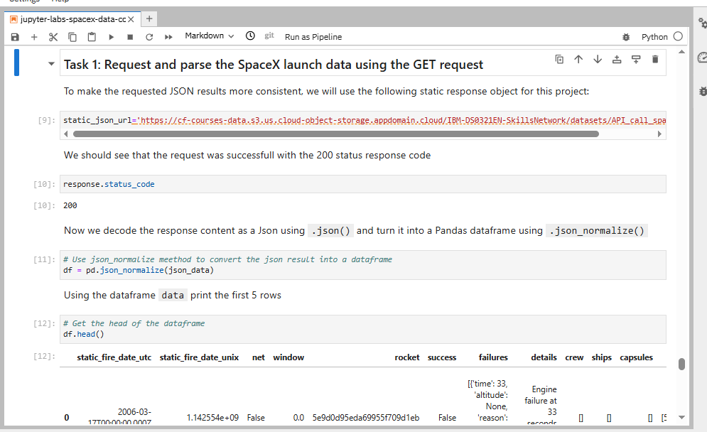
Data Collection – SpaceX API
Here we ae doing to get request to the SpaceX API. You will also do some basic data wrangling and formating.
Request to the SpaceX API
Clean the requested data
https://github.com/hannafarsin/IBM-Data-Science-Proffessional-Certificate-/blob/main/Applied%20Data%20Science%20Capstone/module1/jupyter-labs-spacex-data-collection-api.ipynb
Place your flowchart of SpaceX API calls here

Slide 9
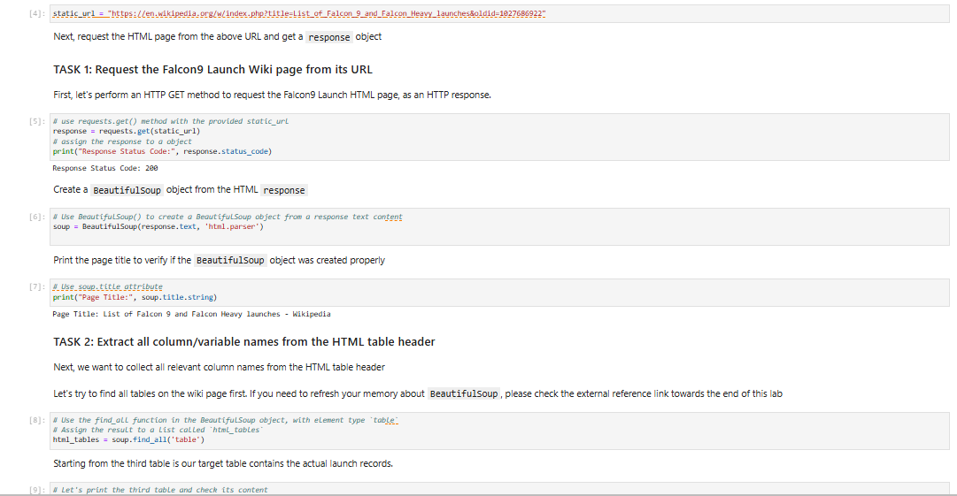
Data Collection - Scraping
Performs web scraping to collect Falcon 9 historical launch records from a Wikipedia page titled `List of Falcon 9 and Falcon Heavy launches`.
Web scrap Falcon 9 launch records with `BeautifulSoup`:
Extract a Falcon 9 launch records HTML table from Wikipedia.
Parse the table and convert it into a Pandas data frame.
https://github.com/hannafarsin/IBM-Data-Science-Proffessional-Certificate-/blob/main/Applied%20Data%20Science%20Capstone/module1/jupyter-labs-webscraping%20(1).ipynb
Place your flowchart of web scraping here

Slide 10
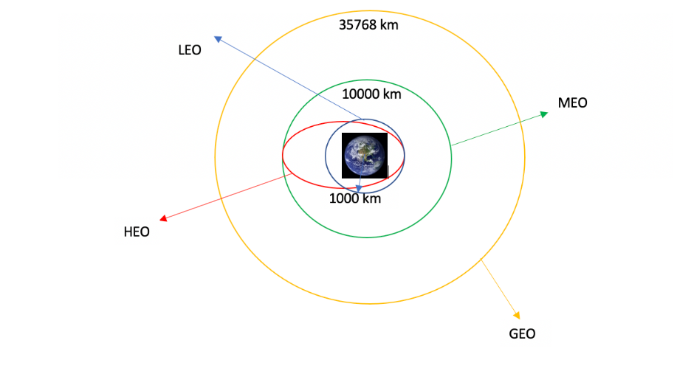
Data Wrangling
In this step we load the dataset and:
Calculate the number of launches on each site
Calculate the number and occurrence of each orbit
Calculate the number and occurence of mission outcome of the orbits
Create a landing outcome label from Outcome column.
https://github.com/hannafarsin/IBM-Data-Science-Proffessional-Certificate-/blob/main/Applied%20Data%20Science%20Capstone/module1/labs-jupyter-spacex-Data%20wrangling.ipynb

Slide 11
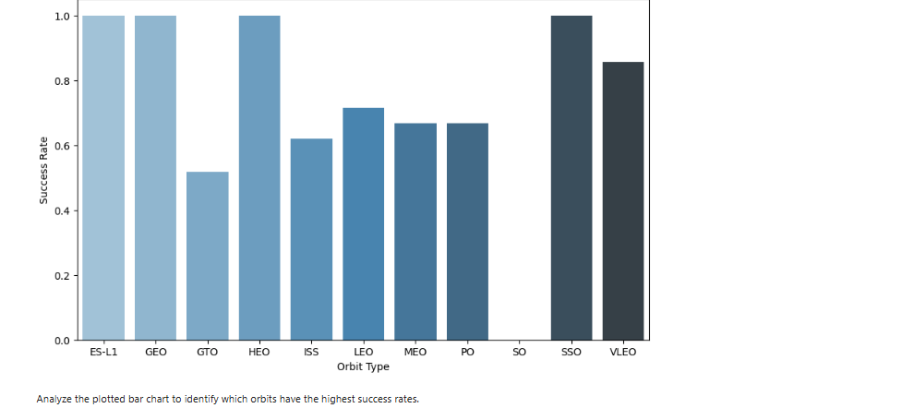
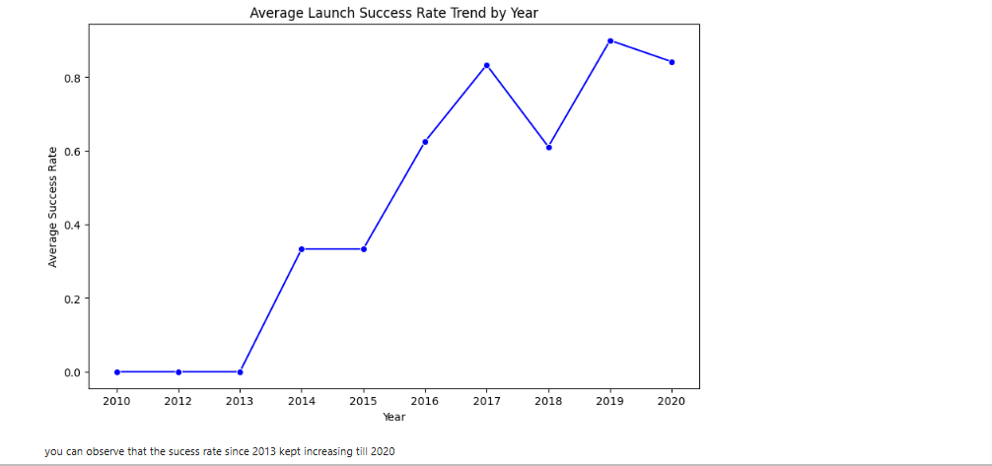
EDA with Data Visualization
Insight:This bar chart shows the launch success rate across different orbit types.
Takeaway: Orbit type has a notable influence on mission success high-priority orbits like GEO and SSO show high performance, whereas GTO may require more optimization or risk mitigation.
Link for the notebook :
https://github.com/hannafarsin/IBM-Data-Science-Proffessional-Certificate/blob/main/Applied%20Data%20Science%20Capstone/module2/edadataviz.ipynb
: Insight:This line chart displays the trend of average launch success rate from 2010 to 2020.
Takeaway: Falcon 9 missions have become significantly more reliable over time, likely due to technological advancements, improved launch procedures, and learning from past missions.

Slide 12
EDA with SQL
Here we have Download the dataset and Connect to the database ,first load the SQL extension and establish a connection with the database and write and execute SQL queries to solve the assignment tasks.
Display the names of the unique launch sites in the space mission
Display 5 records where launch sites begin with the string 'CCA'
Display the total payload mass carried by boosters launched by NASA (CRS)
Display average payload mass carried by booster version F9 v1.1
List the date when the first succesful landing outcome in ground pad was acheived.
List the names of the boosters which have success in drone ship and have payload mass greater than 4000 but less than 6000
List the total number of successful and failure mission outcomes
List the names of the booster_versions which have carried the maximum payload mass. Use a subquery
List the records which will display the month names, failure landing_outcomes in drone ship ,booster versions, launch_site for the months in year 2015.
Rank the count of landing outcomes (such as Failure (drone ship) or Success (ground pad)) between the date 2010-06-04 and 2017-03-20, in descending order.
Notebook link:https://github.com/hannafarsin/IBM-Data-Science-Proffessional-Certificate-/blob/main/Applied%20Data%20Science%20Capstone/module2/jupyter-labs-eda-sql-coursera_sqllite.ipynb

Slide 13
Build an Interactive Map with Folium
We marked all launch sites, and added map objects such as markers, circles, lines to mark the success or failure of launches for each site on the folium map.
We assigned the feature launch outcomes (failure or success) to class 0 and 1.i.e., 0 for failure, and 1 for success.
Using the color-labeled marker clusters, we identified which launch sites have relatively high success rate.
We calculated the distances between a launch site to its proximities. We answered some question for instance:
Are launch sites near railways, highways and coastlines.
Do launch sites keep certain distance away from cities.
Notebook link: https://github.com/hannafarsin/IBM-Data-Science-Proffessional-Certificate-/blob/main/Applied%20Data%20Science%20Capstone/module3/lab_jupyter_launch_site_location.ipynb

Slide 14
Build a Dashboard with Plotly Dash
We built an interactive dashboard with Plotly dash
We plotted pie charts showing the total launches by a certain sites
We plotted scatter graph showing the relationship with Outcome and Payload Mass (Kg) for the different booster version.
Notebook link: https://github.com/hannafarsin/IBM-Data-Science-Proffessional-Certificate-/blob/main/Applied%20Data%20Science%20Capstone/module3/spacex-dash-app.py

Slide 15
Predictive Analysis (Classification)
We loaded the data using numpy and pandas, transformed the data, split our data into training and testing.
We built different machine learning models and tune different hyperparameters using GridSearchCV.
We used accuracy as the metric for our model, improved the model using feature engineering and algorithm tuning.
We found the best performing classification model.
Notebook link: https://github.com/hannafarsin/IBM-Data-Science-Proffessional-Certificate-/blob/main/Applied%20Data%20Science%20Capstone/module4/SpaceX_Machine%20Learning%20Prediction_Part_5%20(1).ipynb

Slide 16
Results
Exploratory data analysis results
Interactive analytics demo in screenshots
Predictive analysis results

Slide 17

Section 2

Slide 18
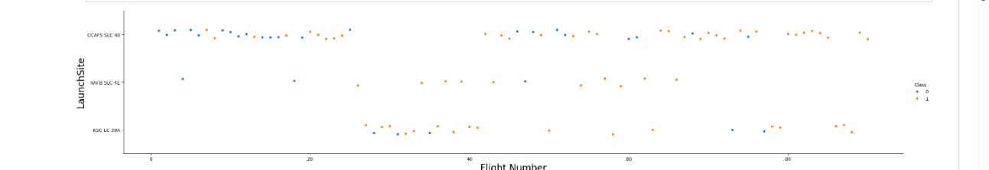
Flight Number vs. Launch Site
This scatter plot shows the relationship between Flight Number and Launch Site, with color
indicating launch success (class = 1) or failure (class = 0). We can observe that most launches were
conducted from CCAFS SLC 40, with a high success rate (many orange dots). KSC LC 39A also shows
a strong success trend, especially in later flights. The trend suggests an improvement in success rate
over time across all sites.

Slide 19
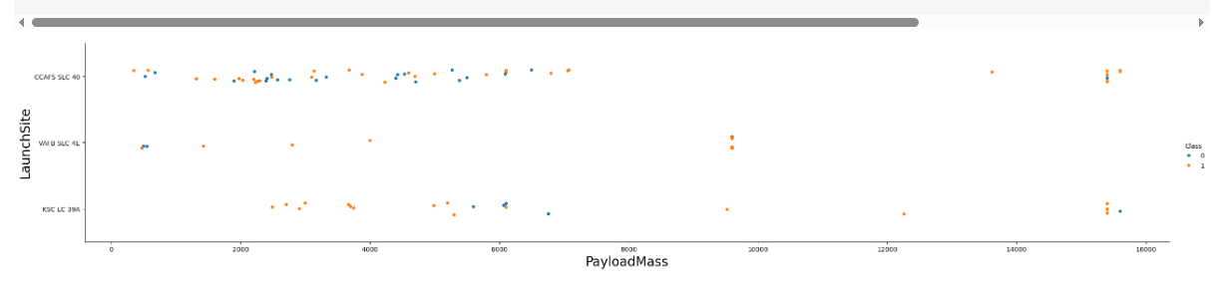
Payload vs. Launch Site
This scatter plot illustrates the relationship between Payload Mass and Launch Site, with color indicating launch success (1) or failure (0). Most payloads between 2,000 kg to 6,000 kg tend to have a higher success rate (more orange dots), especially from CCAFS SLC 40. Heavier payloads (above 10,000 kg) still show a good number of successes, suggesting payload size is not the only factor influencing launch success. Some failures are scattered across all payload ranges, indicating that launch outcome also depends on other variables like site, booster type, or mission complexity.

Slide 20
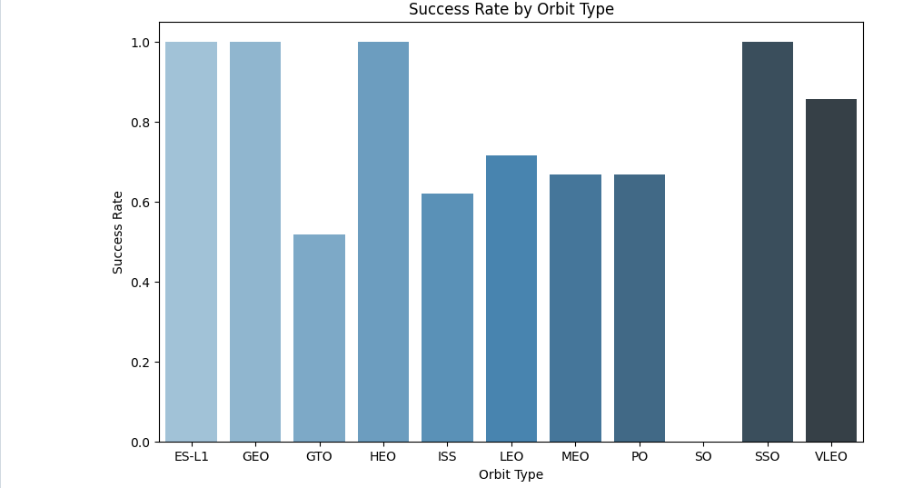
Success Rate vs. Orbit Type
This bar chart shows the Success Rate by Orbit Type. The orbit types ES-L1, GEO, HEO,
and SSO achieved a 100% success rate, indicating highly reliable missions to these orbits. VLEO and
LEO also demonstrate strong performance with success rates above 70%. However, GTO
(Geostationary Transfer Orbit) has the lowest success rate, around 52%, suggesting that missions to
GTO might be more complex or risk-prone. Overall, orbit type appears to be a significant factor in
predicting mission success.

Slide 21
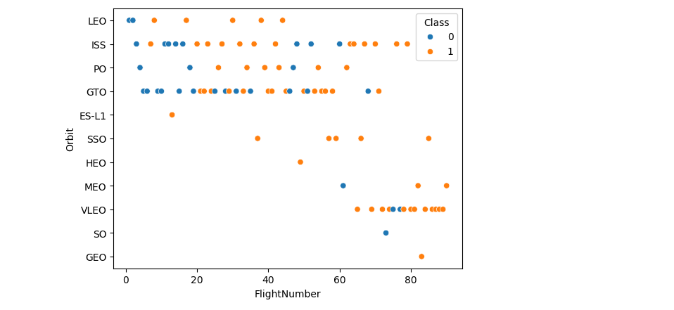
Flight Number vs. Orbit Type
100% Success rate of GEO,HEO and ES-L1 orbits can be explained by only having 1 flight into the respective orbits..
The plot below shows the Flight Number vs. Orbit type. We observe that in the LEO orbit, success is related to the number of flights whereas in the GTO orbit, there is no relationship between flight number and the orbit.

Slide 22
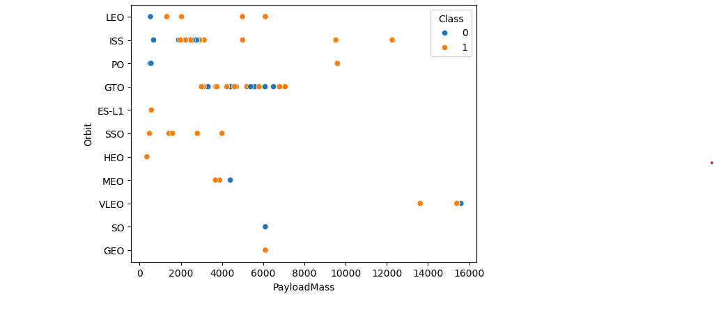
Payload vs. Orbit Type
This scatter plot shows that PO (although the number of datapoint is small) ,ISS and LEO have more success with heavy payloads.
For GTO the relationship between payload mass and success rate is unclear.

Slide 23
Launch Success Yearly Trend
This line chart displays the trend of average launch success rate from 2010 to 2020.
Very low or zero success rate before 2013.
A significant and steady increase from 2013 onwards, peaking in 2019.
A slight dip in 2020, but the overall trend shows substantial improvement over the decade.
Falcon 9 missions have become significantly more reliable over time, likely due to technological advancements, improved launch procedures, and learning from past missions.

Slide 24
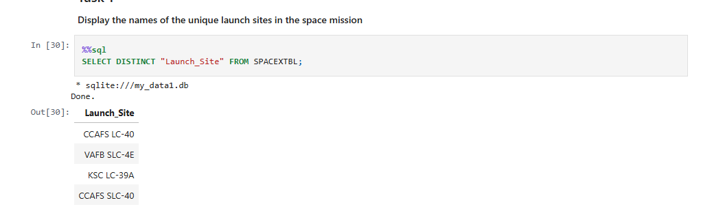
All Launch Site Names
We used the key word DISTINCT to show only unique launch sites from the SpaceX data.

Slide 25
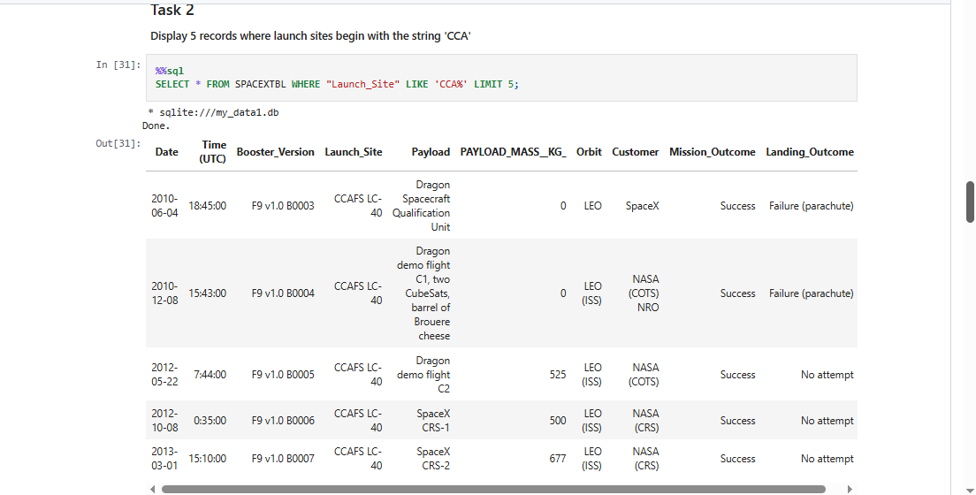
Launch Site Names Begin with 'CCA'
We used the query above to display 5 records where launch sites begin with `CCA`

Slide 26
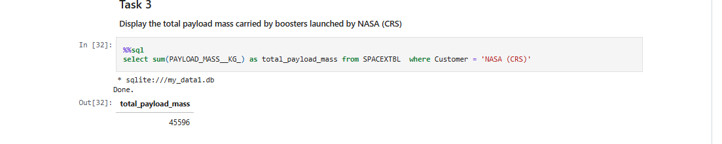
Total Payload Mass
We calculated the total payload carried by boosters from NASA as 45596 using the query below

Slide 27
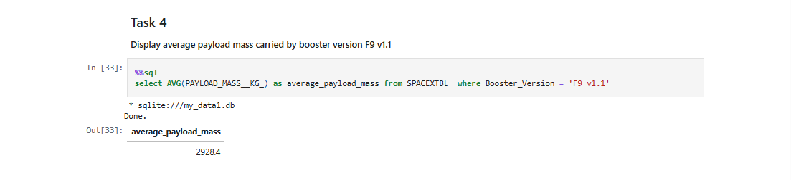
Average Payload Mass by F9 v1.1
We calculated the average payload mass carried by booster version F9 v1.1 as 2928.4

Slide 28
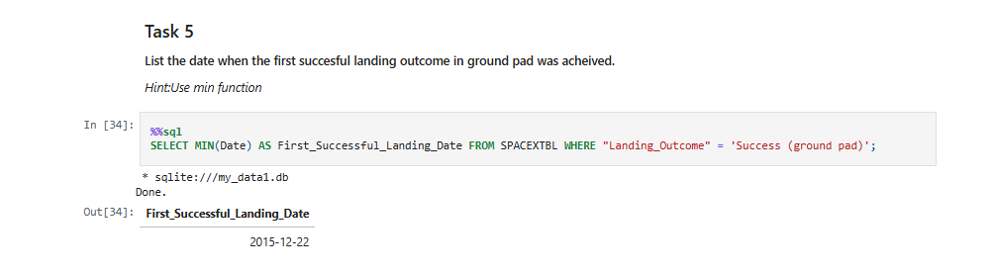
First Successful Ground Landing Date
We observed that the dates of the first successful landing outcome on ground pad was 22nd December 2015

Slide 29
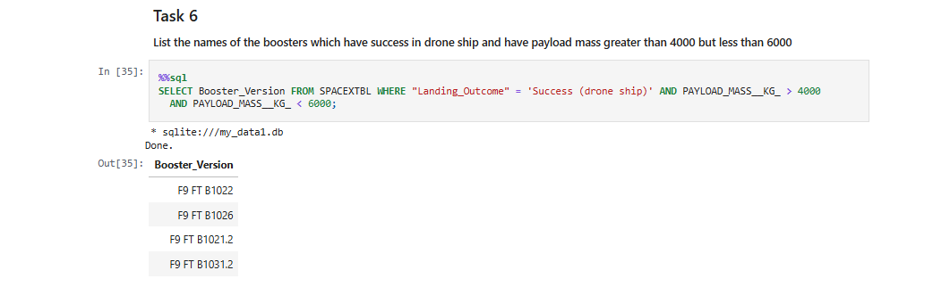
Successful Drone Ship Landing with Payload between 4000 and 6000
We used the WHERE clause to filter for boosters which have successfully landed on drone ship and applied the AND condition to determine successful landing with payload mass greater than 4000 but less than 6000

Slide 30
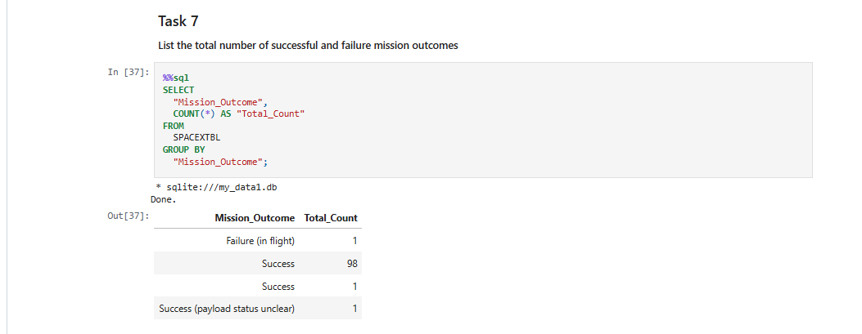
Total Number of Successful and Failure Mission Outcomes
We used COUNT to get the total count and used GROUP BY to get the successful and failure mission outcome.

Slide 31
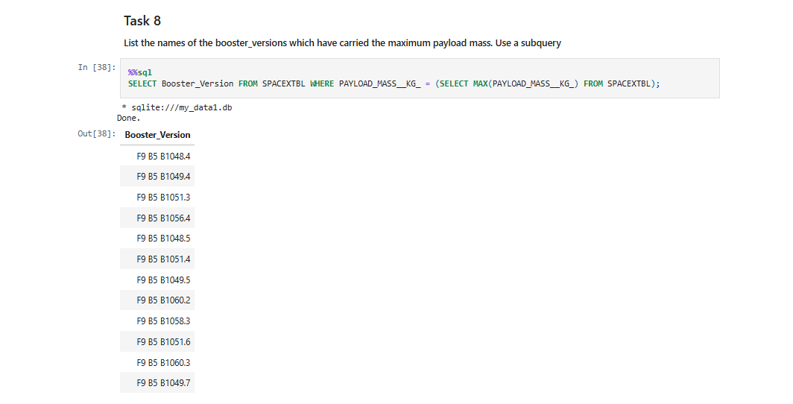
Boosters Carried Maximum Payload
We determined the booster that have carried the maximum payload using a subquery in the WHERE clause and the MAX() function.

Slide 32
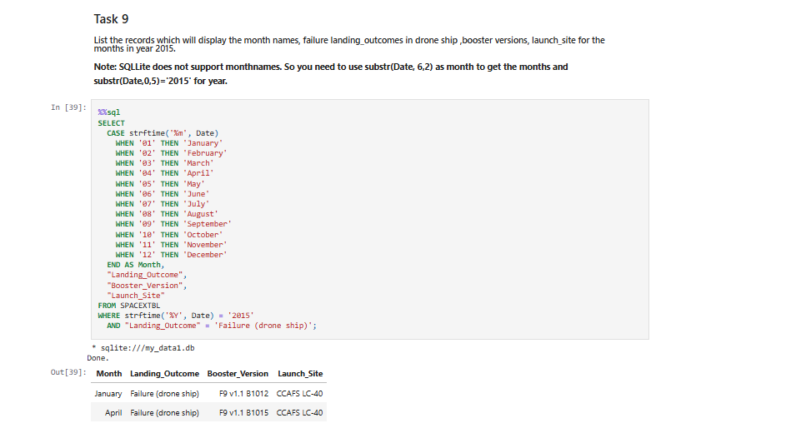
2015 Launch Records
retrieves the month name, landing outcome, booster version, and launch site for all SpaceX launches in 2015 where the landing failed on a drone ship, and shows the month as a full word (e.g., "January" instead of "01").

Slide 33
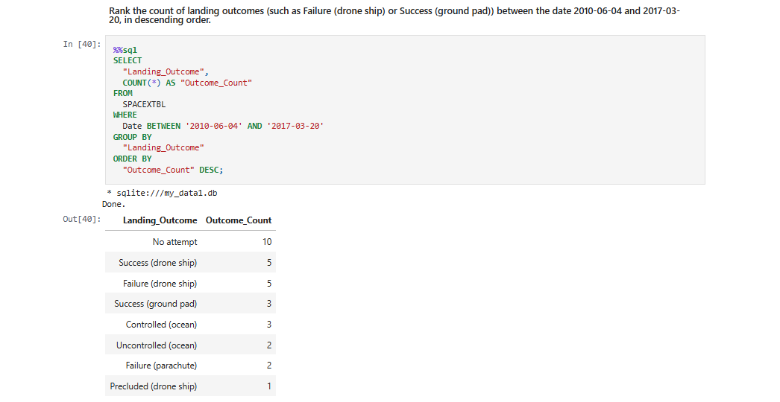
Rank Landing Outcomes Between 2010-06-04 and 2017-03-20
We selected Landing outcomes and the COUNT of landing outcomes from the data and used the WHERE clause to filter for landing outcomes BETWEEN 2010-06-04 to 2010-03-20.
We applied the GROUP BY clause to group the landing outcomes and the ORDER BY clause to order the grouped landing outcome in descending order.

Slide 34

Section 3

Slide 35
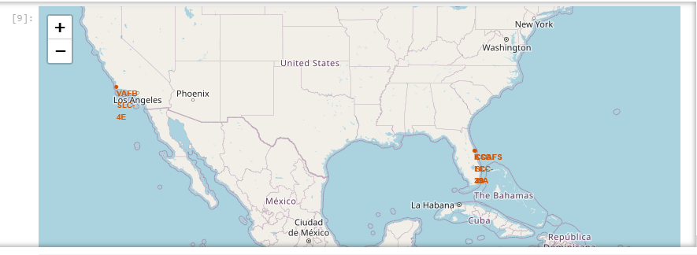
All launch sites global map markers
Explanation:
Most of Launch sites considered in this project are in proximity to the Equator line. Launch sites are made at the closest point possible to Equator line, because anything on the surface of the Earth at the equator is already moving at the maximum speed (1670 kilometers per hour). For example launching from the equator makes the spacecraft move almost 500 km/hour faster once it is launched compared half way to north pole.
All launch sites considered in this project are in very close proximity to the coast While starting rockets towards the ocean we minimise the risk of having any debris dropping or exploding near people.

Slide 36
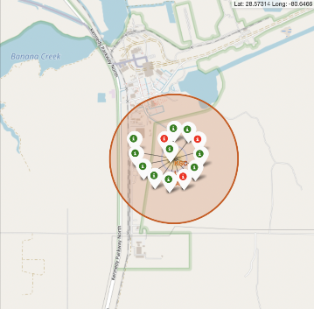
Color-Labeled Launch Record on the Map
Explanation:
• From the colour-labeled markers we should be able to easily identify which launch sites have relatively high success rates.
Green Marker = Successful Launch
Red Marker = Failed Launch Launch Site KSC LC-39A has a
very high Success Rate.

Slide 37
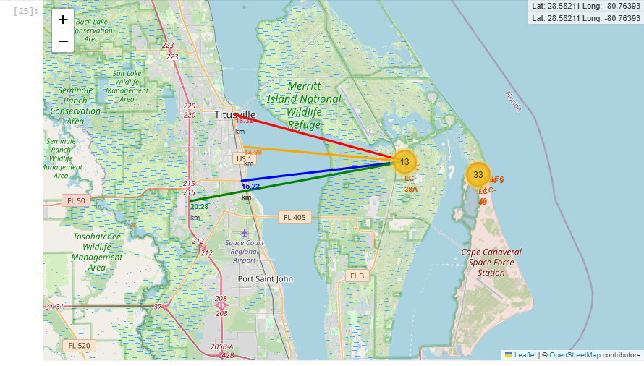
Launch Site Distance To Landmark
From the visual analysis of the launch site KSC LC-39A we can clearly see that it is:
relative close to railway (15.23 km)
relative close to highway (20.28 km)
relative close to coastline (14.99 km)
Also the launch site KSC LC-39A is relative close to its closest city Titusville (16.32 km).
Failed rocket with its high speed can cover distances like 15-20 km in few seconds. It could be potentially dangerous to populated areas.

Slide 38

Section 4

Slide 39
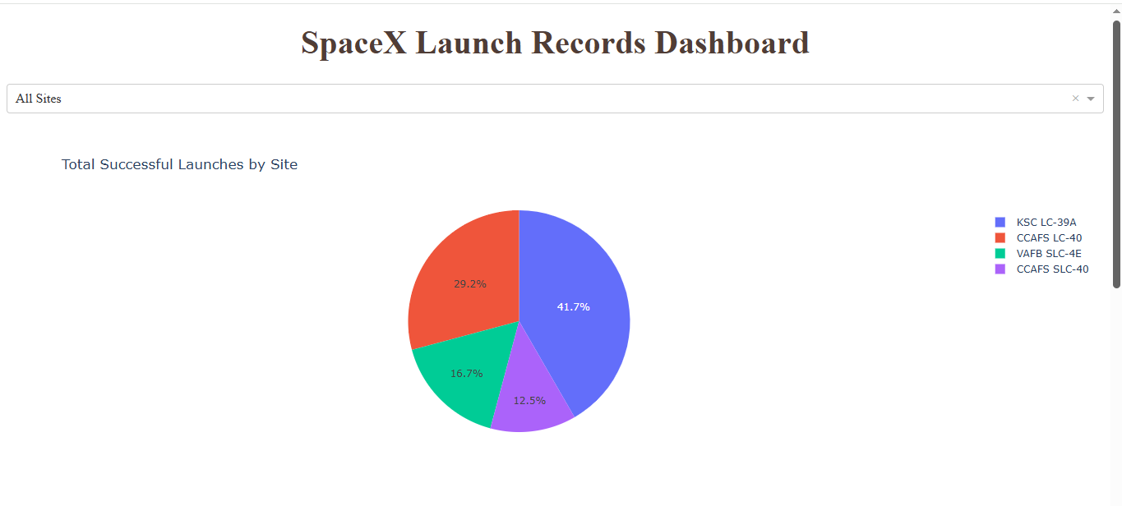
SpaceX Launch Records For All Site
Explanation:
We can see that KSC LC-39A has most successful Launches

Slide 40
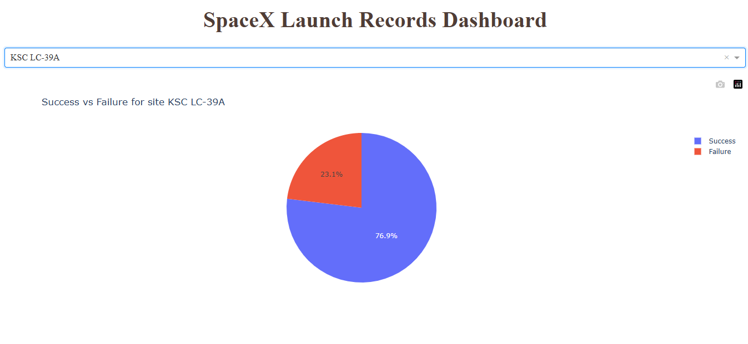
Launch Site with Highest Launch Success Ratio
Explanation:KSC LC-39A has the highest launch success rate (76.9%) with 10 successful and only 3 landing failings.

Slide 41
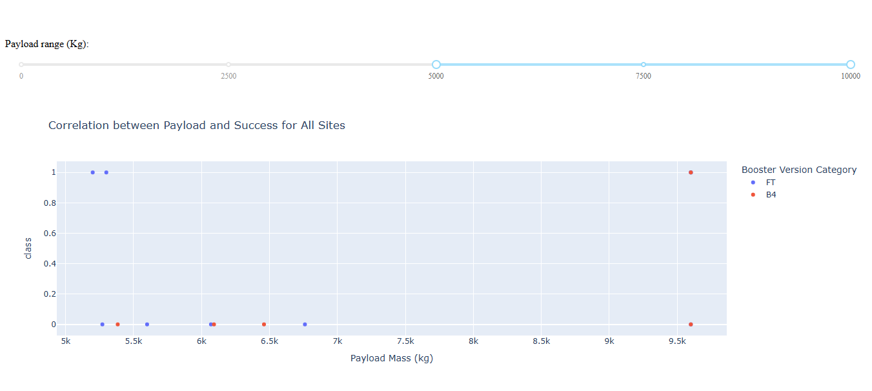
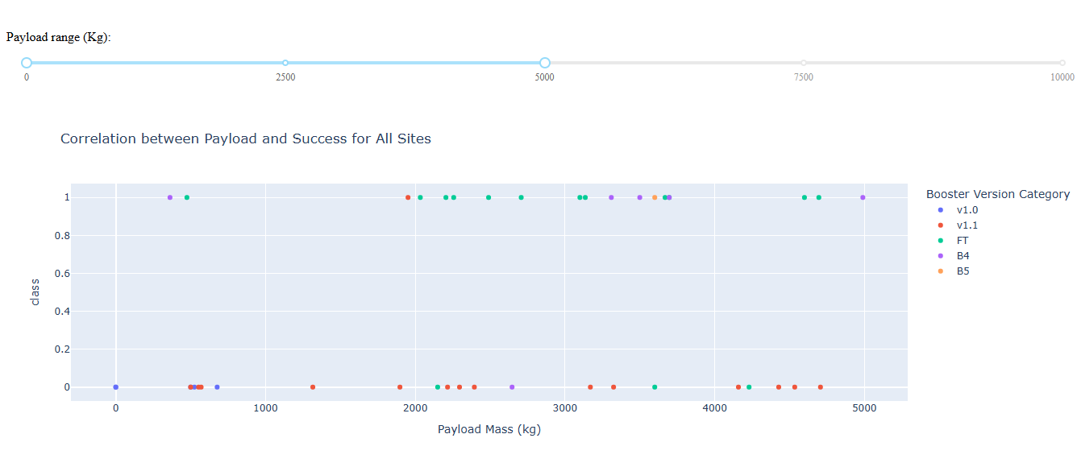
Payload Mass vs Launch outcome for all sites
we can see success rates for low weighted payloads is higher than the heavy weighted payloads

Slide 42

Section 5

Slide 43
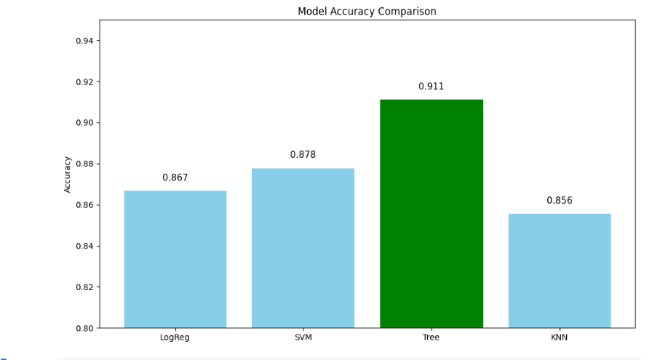
Classification Accuracy
Inference: The bar chart shows that the Decision Tree classifier achieved the highest accuracy (0.911), outperforming Logistic Regression, SVM, and KNN. This suggests that the Decision Tree model is the best-performing classifier for this dataset in terms of prediction accuracy.

Slide 44
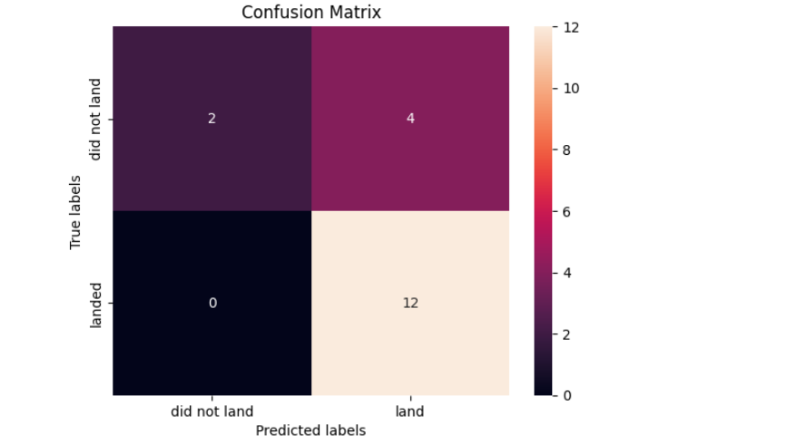
Confusion Matrix
The confusion matrix for the decision tree classifier shows that the classifier can distinguish between the different classes. The major problem is the false positives .i.e., unsuccessful landing marked as successful landing by the classifier.

Slide 45
Conclusions
1. Successful Prediction is Feasible
The prediction of Falcon 9 first-stage landing success is achievable with high accuracy using historical data. The best-performing model (Decision Tree) achieved 91.1% accuracy, showing that landing outcomes are predictable with the right features and model.
2. Decision Tree Outperforms Others
Among the tested models—Logistic Regression, SVM, KNN, and Decision Tree—the Decision Tree classifier gave the highest performance in terms of:
Accuracy
F1 Score
Jaccard Score
This implies it captured the most informative patterns in the data, possibly due to its ability to model nonlinear relationships and handle mixed-type features well.
3. Data Quality & Feature Engineering Matter
The preprocessing steps (like encoding, normalization, and feature selection) were critical in ensuring accurate predictions. Well-prepared data helped the models perform consistently across metrics.

Slide 46
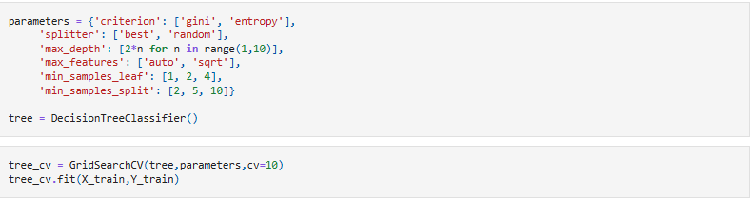
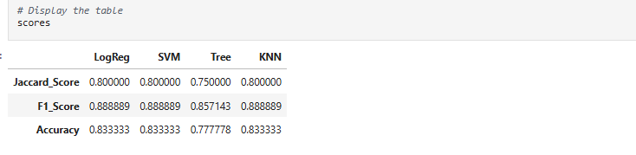
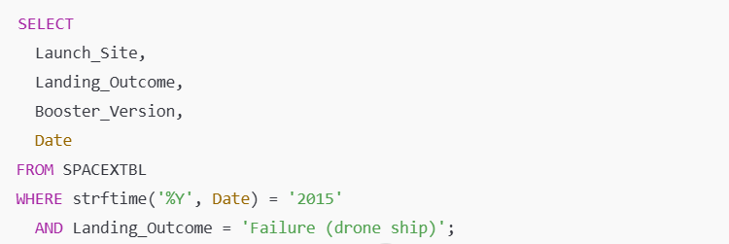
This DataFrame neatly shows Jaccard, F1, and Accuracy for all models:
Appendix
1. Model Training: shows how you trained and predicted using a Decision Tree (best model)
4. Model Evaluation Scores Table:
2. Filter Failures on Drone Ship in 2015:Used to extract failed landings on drone ships in 2015:
3. Model Accuracy Comparison Bar Chart
->Best model accuracy is Decision tree(91%)

Slide 47


